Slide 1


Superhero
Bump?
A Causal Analysis of
on Actor Careers
Manas Tokale
Robin Luke
Srijan Shetty
Yu Zhuoran
OneDrive_Link

Slide 2

Recap
About The Company
Initial Hypothesis
Preliminary Analysis & Feedback
Research Question
Hypotheses
Data Collection
Exploratory Data Analysis
Causal Framework
Model Setup
Staggered DiD
Need of Control Variables
Logic of the co-efficient
Model Insights
Conclusion
Conclusion
Limitation & Future Scope
Table Of Contents

Slide 3

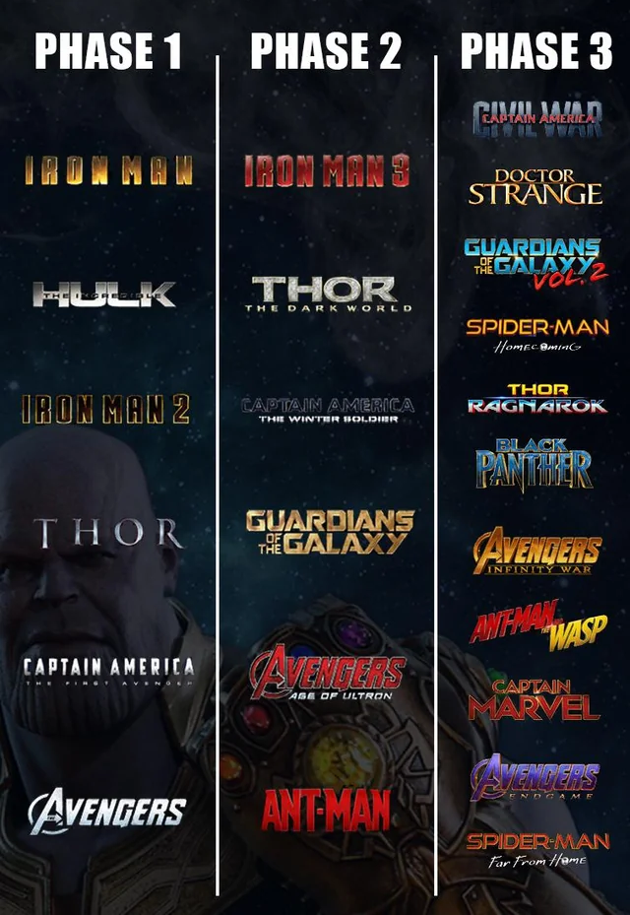
1. Recap
About Infinity Saga
MCU redefined franchise storytelling with its Infinity Saga
23 movies
over the course of 2008–2019
divided into 3 phases
establishing interconnected narratives that fostered
strong character loyalty and
brand equity.​
About Marvel
Marvel Cinematic Universe (MCU), under The Walt Disney Company, has emerged as a monumental success in the film industry, amassing over $29 billion globally. ​

Slide 4
1. Recap
Initial Hypothesis 1
Initial Hypothesis 1
The 2nd hypothesis was discarded based on the professor’s feedback. Reasons:
Different time periods
Unclean comparison
Does an actor’s box office performance change significantly after joining the MCU?
Do Spider-Man movies perform better when part of the MCU compared to standalone Sony productions?
Modified a little
Discarded
Did appearing in the MCU’s Infinity Saga (2008–2019) cause a measurable improvement in an actor’s post-treatment career trajectory, compared to similar actors who did not appear in the Infinity Saga?

Slide 5

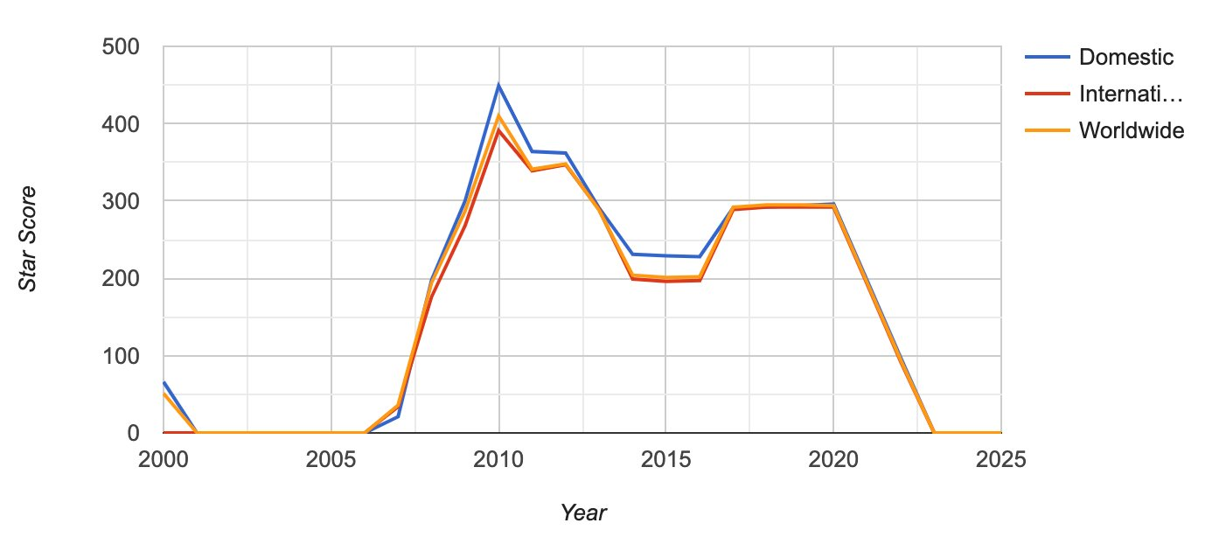
1. Recap
Preliminary Analysis
Actor’s box office earnings increase post-MCU debut.
Based on initial sample of data taken For example: Robert Downey Jr.
Also compared to similar actors during the same time-frame like Gerard Butler
Initial Feedback
1. Clarify Concepts
Distinguish hypotheses from questions; define pre/post consistently; generalize beyond case studies.
2. Tighten Slides
Improve slide flow;
clearly link data sources to variables; remove irrelevant visuals.
3. Sharpen Analysis
Use annotations on plots;
isolate effects of first MCU appearance;

Slide 6
2. Research
Question
Research Question
To determine if actor`s participation in the MCU's Infinity Saga causally impacted their box office success and career visibility, focusing on measurable career outcomes
(i.e financial metrics and popularity indicators).
Hypothesis
Alternate Hypothesis (H₀): Participation in the MCU causes a statistically significant increase in an actor’s average opening weekend box office performance, controlling for film count, average movie ratings, and lead-role appearances.
Null Hypothesis (H₁): Participation in the MCU has no causal effect on an actor’s average opening weekend box office performance, after accounting for film count, average movie ratings, and lead-role appearances.

Slide 7
3. Data Collection
Treatment Group
Control Group
Robert Downey Jr.
Chris Evans
Scarlett Johansson
Mark Ruffalo
Jeremy Renner
Tom Holland
Benedict Cumberbatch
Chadwick Boseman
Paul Rudd
Tom Hiddleston
Chris Pratt
Chris Hemsworth
Jim Carey
Ryan Reynolds
Charlize Theron
Edward Norton
Ben Foster
Tye Sheridan
Matthew Goode
John David Washington
Steve Carell
Taron Egerton
Channing Tatum
Sam Worthington.
The actors were selected based on a few manually validated assumptions:
Similar career trajectory pre MCU start point in terms of:
Box Office Revenue of movies
No. of Lead Roles played
Opening weekend collection
Film Count distribution
Genres
Sample Size is around 700 across 24 categories which follows a ratio of 1:28 data points per sample

Slide 8







3. Data Collection
1. Online API based sources
TMDb, IMDB, RT, BOMojo, Number
2. Python
Scrape REST data using Python
3. Google Colab
Used for Exploratory Data Analysis
Used for Causal Analysis
We perform elementary data pre-processing and move on to Exploratory Data Analysis

Slide 9
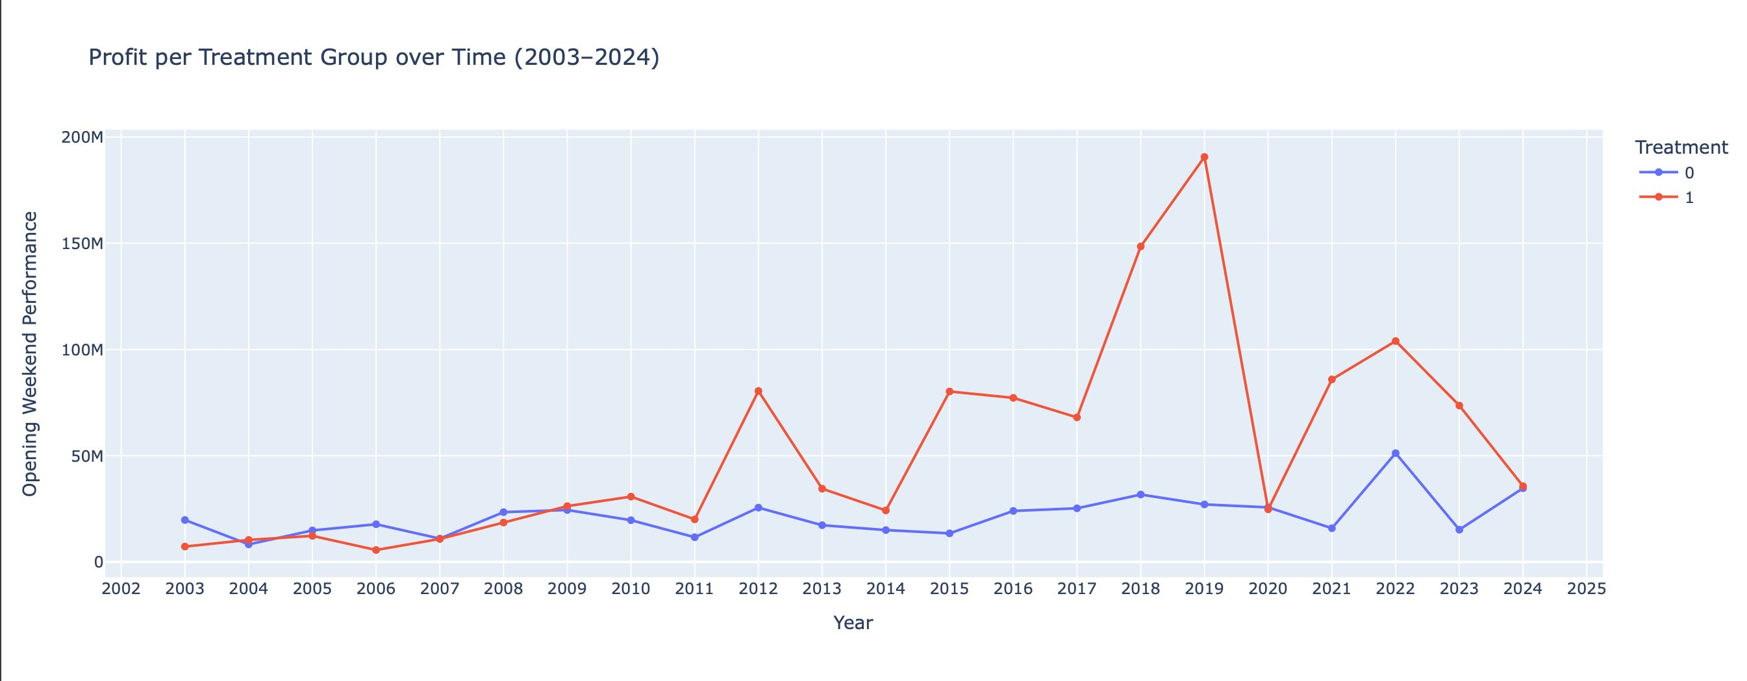
4. Exploratory
Data Analysis
To verify that our data supports the parallel trends assumption to proceed with a staggered Difference in Difference model
This plot shows that prior to MCU entry (pre-2008-2012), both treated and control actors had similar trends in opening weekend performance, supporting the parallel trends assumption. Post-treatment, treated actors show a sharp revenue increase, indicating a potential positive causal effect of MCU participation.

Slide 10
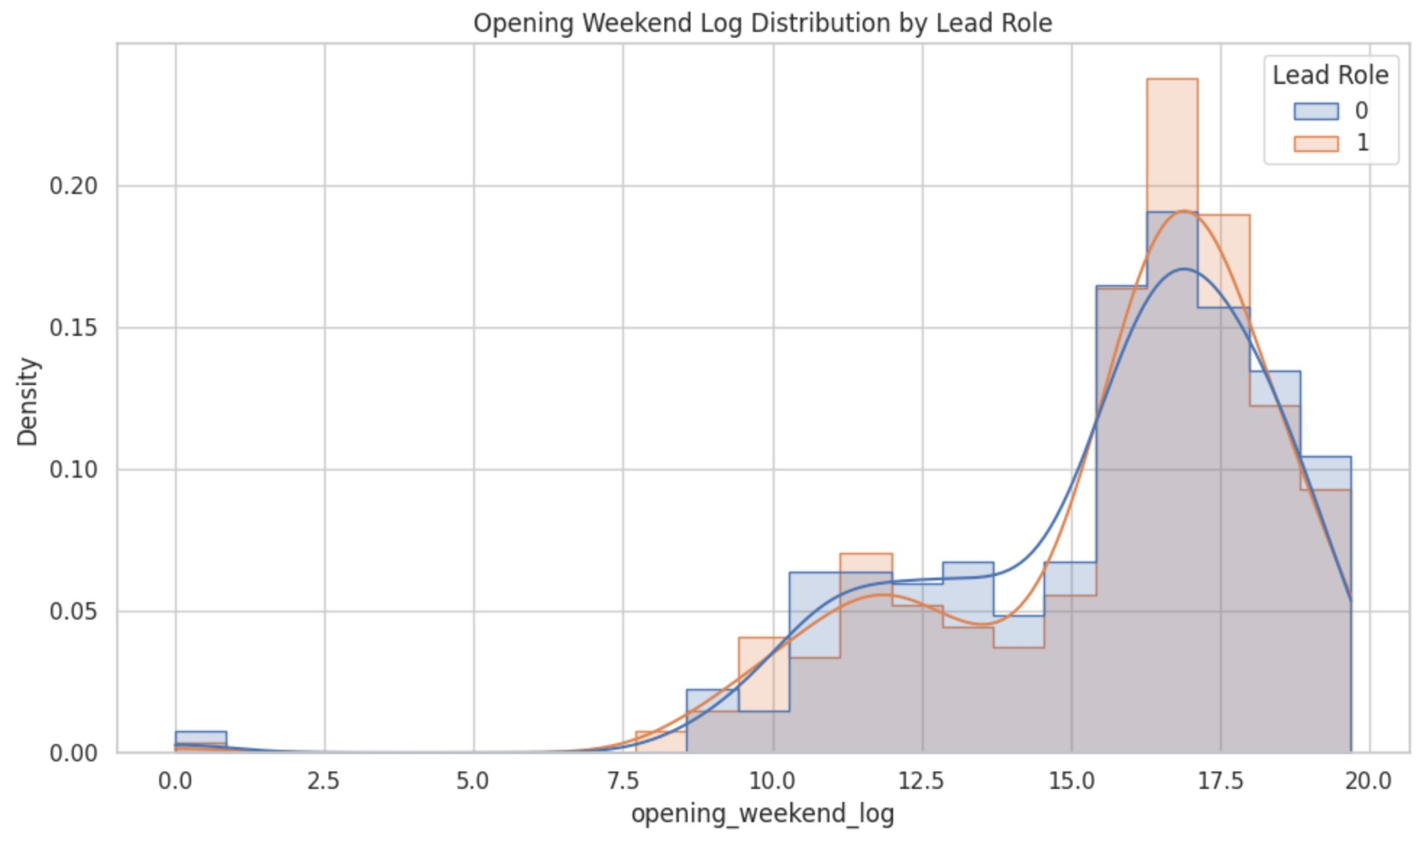
4. Exploratory
Data Analysis
To verify that our data supports the parallel trends assumption to proceed with a staggered Difference in Difference model
This plot shows that:
Both distributions are right-skewed and largely overlapping, but the lead role distribution is slightly shifted right, suggesting that lead actors tend to generate higher opening weekend revenues.​
The higher density around 17–18 for lead roles indicates more frequent success at higher box office openings when actors are cast as leads.​

Slide 11
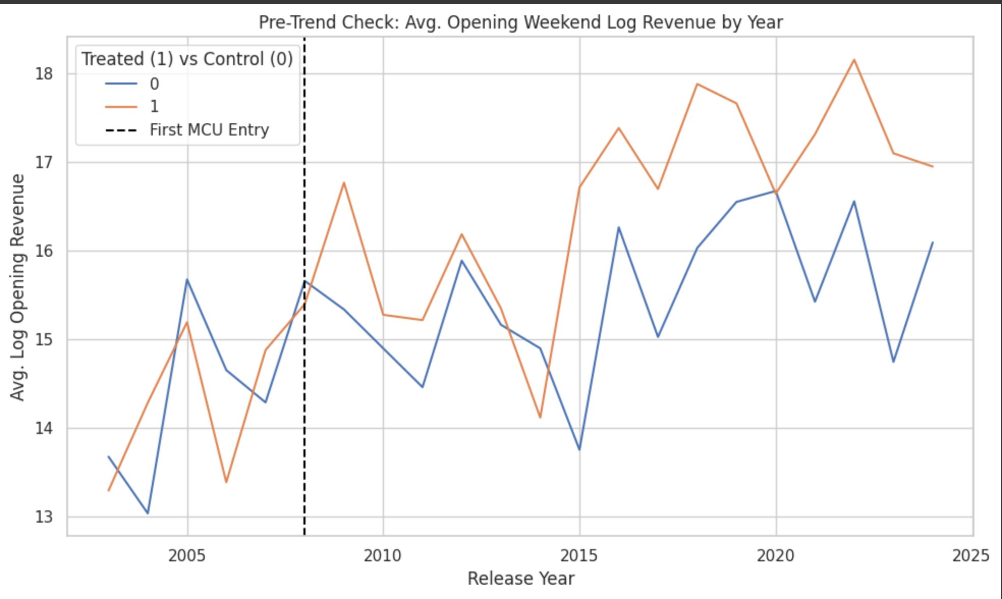
4. Exploratory
Data Analysis
To verify that our data supports the parallel trends assumption to proceed with a staggered Difference in Difference model
This plot shows that:
This pre-trend check shows that treated and control groups had parallel trends in average log opening weekend revenue before MCU entry (2008).​
The divergence after 2008 supports the parallel trends assumption for staggered DiD, suggesting a treatment effect from MCU involvement.​

Slide 12
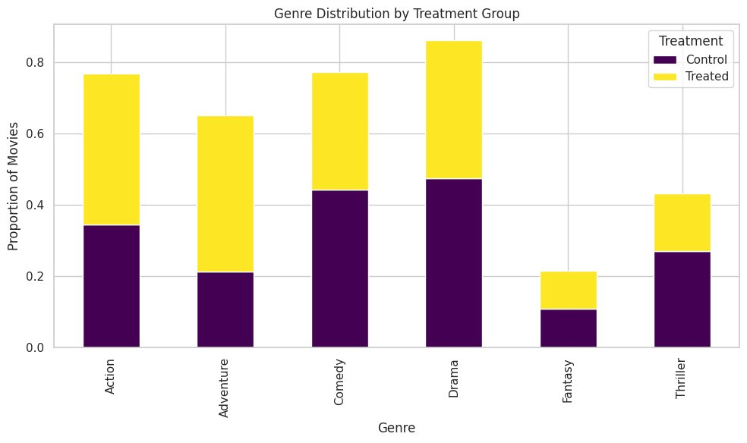
4. Exploratory
Data Analysis
To verify that our data supports the parallel trends assumption to proceed with a staggered Difference in Difference model
This plot shows that:
treated actors (MCU entrants) are more represented in Action and Adventure genres, while control actors lean slightly more toward Drama and Comedy.​
This genre skew may confound treatment effects, highlighting the importance of genre controls in causal models.​

Slide 13
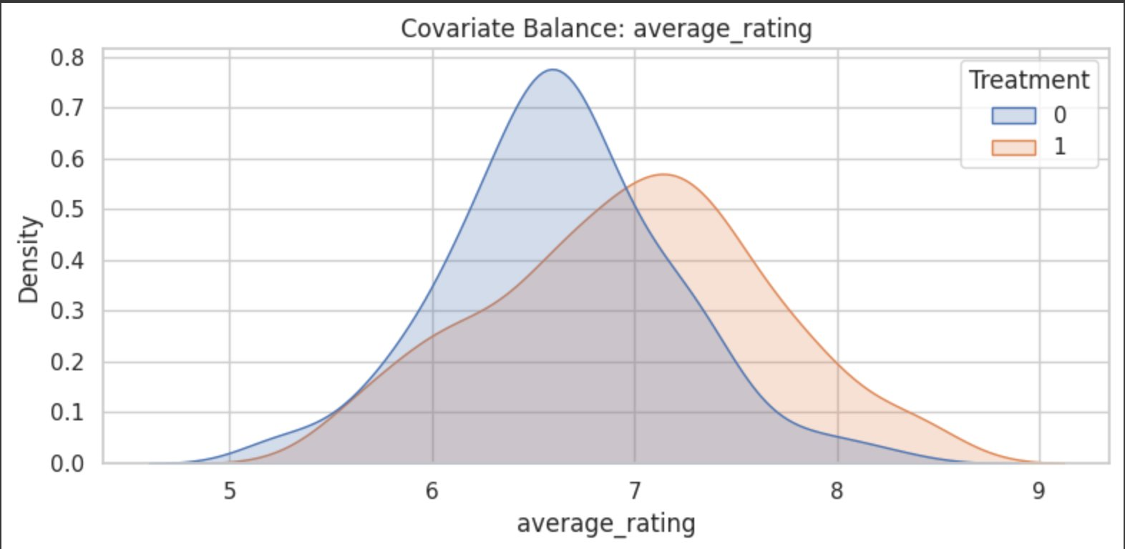
4. Exploratory
Data Analysis
To verify that our data supports the parallel trends assumption to proceed with a staggered Difference in Difference model
This plot shows that:
treated actors tend to appear in movies with higher average ratings than control actors, showing some covariate imbalance. This suggests that adjustment or matching may be necessary to isolate the causal impact of MCU entry.​

Slide 14
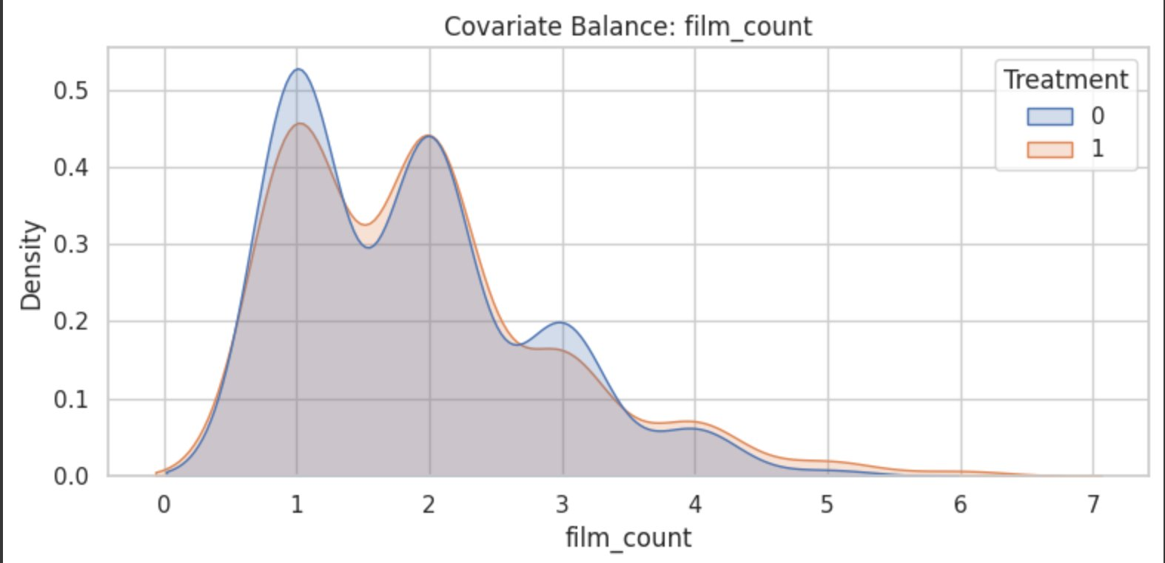
4. Exploratory
Data Analysis
To verify that our data supports the parallel trends assumption to proceed with a staggered Difference in Difference model
This plot shows that:
film count distribution is well balanced across treated and control groups, supporting the validity of comparisons in our causal analysis. It suggests that actors in both groups had similar levels of prior exposure.​

Slide 15
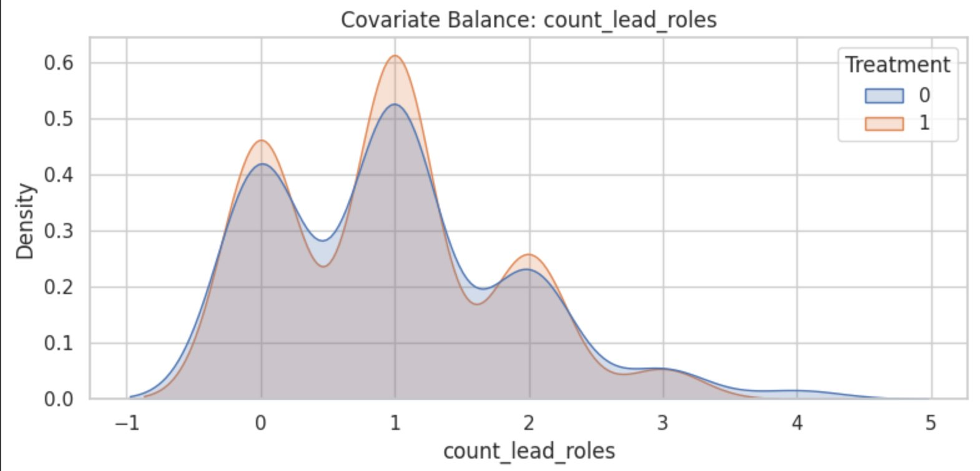
4. Exploratory
Data Analysis
To verify that our data supports the parallel trends assumption to proceed with a staggered Difference in Difference model
This plot shows that:
the distribution of lead roles is closely matched between treated and control groups, indicating good covariate balance and reducing the risk of selection bias in our causal inference.​

Slide 16
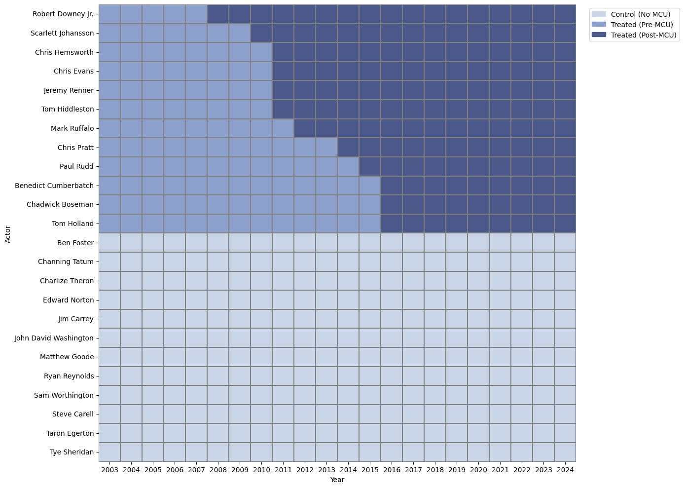
5. Causal Framework
Staggered DiD Heatmap
We structure our dataset for the
Treatment (Entry in MCU)
vs
Control (never entered MCU)
like this.
All aggregations done annually.

Slide 17
5. Causal Framework
Staggered DiD model
Estimating MCU Impact on Opening Weekend Revenue​
Variables​
OpeningWeekendit : Log of the average opening weekend box office performance for actor i in year t​
Dit : Treatment indicator (e.g., post-MCU entry dummy)​
FilmCount it : Total number of films released by actor i in year t​
AvgRating it : Average movie rating for actor i in year t​
LeadRoles it: Number of lead roles played by actor i in year t​
α i : Actor fixed effects​
γt : Year fixed effects​
εt : Error term​
ln(OpeningWeekendit​)=β⋅Dit​+θ1​⋅FilmCountit​+θ2​⋅AvgRatingit​+θ3​⋅LeadRolesit​+αi​+γt​+εit​​
β estimates the causal effect of MCU entry on an actor’s opening weekend performance, holding constant both actor-specific traits and year-specific shocks.​

Slide 18



5. Causal Framework
What Do Control Variables Do in a DiD Model?​
Control variables help isolate the true effect of treatment (e.g., MCU entry) by accounting for other influences.​
Why Include Controls?​​ Control variables serve three core purposes in a causal (DiD) model:​
​Rule Out Alternative Explanations​
Hold constant other factors (e.g., film count, ratings) that impact the outcome​
Ensures treatment effect isn’t confounded by unrelated trends​
​
Reduce Omitted Variable Bias​
Prevents incorrect attribution of effects to the treatment​
Ex: Without controlling for film count, higher revenue may wrongly appear MCU-driven​
Increase Statistical Precision​
Explains residual variation → lowers standard errors​
Makes treatment effects easier to detect confidently​​

Slide 19

5. Causal Framework
Logic of the co-efficient​
Actor Dummy :
Difference from reference actor → captures actor-specific traits (e.g., popularity, genre).​
Year Dummy :
Difference from reference year → captures industry-wide shocks (e.g., COVID, streaming trends).​
Purpose:
Isolate true treatment effects (e.g., MCU entry) by holding actor & year effects constant.​

Slide 20
5. Causal Framework
Model Insights
β is the causal estimate:
the average percentage change in opening‑weekend revenue attributable to joining the MCU,
after accounting for workload, film quality, screen presence, and common year shocks.​
Coefficient​ | Estimate​ | p‑value​ | Economic interpretation*​
Treatment​ | + 2.085 log‑pts​ | 0.000​ | ≈ + 705 % to opening‑weekend gross once an actor appears in the MCU.(e^2.085 ≈ 8.05 ⇒ 8× larger weekends)​
*Percent effect = e^β – 1
Take‑away: after you net out actor fixed traits, year shocks, workload, and film quality, an MCU role multiplies the actor’s annual opening‑weekend takings by roughly eight‑fold. That is both economically and statistically enormous, strongly supporting a causal MCU halo.​

Slide 21
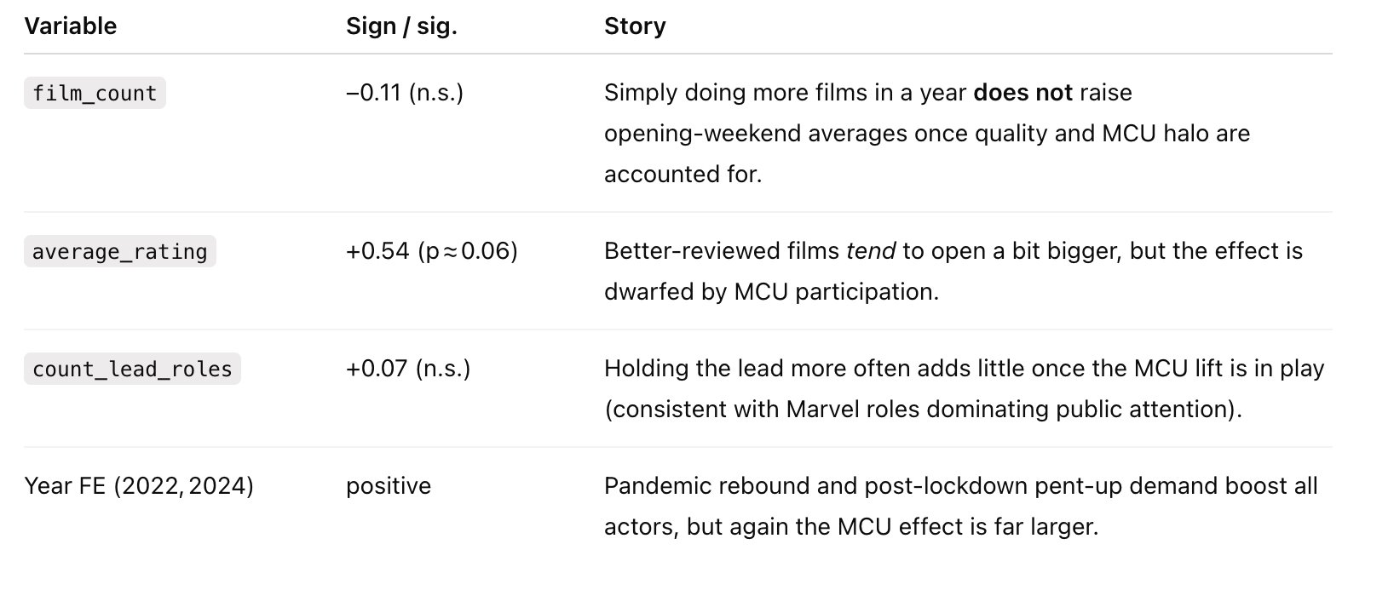
5. Causal Framework
Model Insights

Slide 22
6. Conclusion
The MCU Effect Is Real—and Transformative​!!!
“Becoming an Avenger pays off—spectacularly”​
​
Our causal analysis shows that after an actor's first MCU appearance, their average opening-weekend box office revenue increases by nearly 700%, even after accounting for:​
​
🎥 Number of films released (workload)​
🌟 Critical reception (average ratings)​
📆 Year-specific industry shocks (e.g., COVID, streaming)​
​
📈 Interpretation of the Effect​
​
The magnitude of the treatment coefficient suggests that joining the MCU doesn't just increase visibility—it redefines the actor’s market value.​
Crucially, this jump cannot be explained by output or quality alone—pointing to the MCU brand itself as the primary causal driver of the surge in commercial performance.​

Slide 23
6. Conclusion
Limitations of the analysis
Residual Selection Bias​
Unobserved differences (e.g., career strategy) may still influence results despite actor matching.​
Narrow Financial Lens​
Focuses only on theatrical opening-weekend revenue; excludes streaming or long-term gains.​
Time-Varying Treatment Strength​
MCU’s impact likely differs by entry year, but our model averages across cohorts.​
Future Scope
Model Effect Heterogeneity:​
Early MCU entrants (e.g., RDJ) appear to benefit more than later-phase actors—future work could model these cohort effects explicitly.
Expand the Sample:​
Including more non-MCU A-list actors would improve statistical power and strengthen external validity.​

Slide 24
THANK YOU!

